Slide 1
CMPE - 252 ML PROJECT
G2Net Detecting Continuous Gravitational Waves
Pruthvi Raj Kotigari - 016681522
Ketan Malempati - 016695354
Ashish - 016662360
Western Han - 012261964
Sumanth M- 016648684

Slide 2
INTRODUCTION
Gravitational waves are ripples in space which can be associated with events such as black holes and exploding stars when cataclysmic waves are detected. Humans can’t see these gravitational waves, but with the help of antennas such as LIGO (Laser Interferometer Gravitational-Wave), it can detect vibrations in the medium of space. The medium of space is something scientists are still researching to this day and could play an important role in telling us more about what is in the universe.
The current approaches include techniques for improving the sensitivity of Advanced Laser Interferometer GW Observatory and Advanced Virgo GW searches, methods for fast measurements of the astrophysical parameters of GW sources, and algorithms for the reduction and characterization of non-astrophysical detector noise. These applications demonstrate how machine learning techniques may be harnessed to enhance the science that is possible with current and future GW detectors.

Slide 3
PROJECT DESCRIPTION
The goal of this project is to find continuous gravitational-wave signals. We will develop a model sensitive enough to detect weak yet long-lasting signals emitted by rapidly-spinning neutron stars within noisy data. Our current approach to this dataset is to clean data, do exploratory data analysis, data-preprocessing, train machine learning models, perform hyperparameter optimisation, and evaluation and compare different results of machine learning models. The approach to solving this problem is subject to change since the topic of gravitational waves is vast, and the more research we do could grant us new ways to tackle our goal.
We will be using multiple models like CNN, LSTM and many more and compare them.
We are going to do optimizations to these models like hyperparameter optimization and make comparisons with the same model but with different hyperparameters.

Slide 4
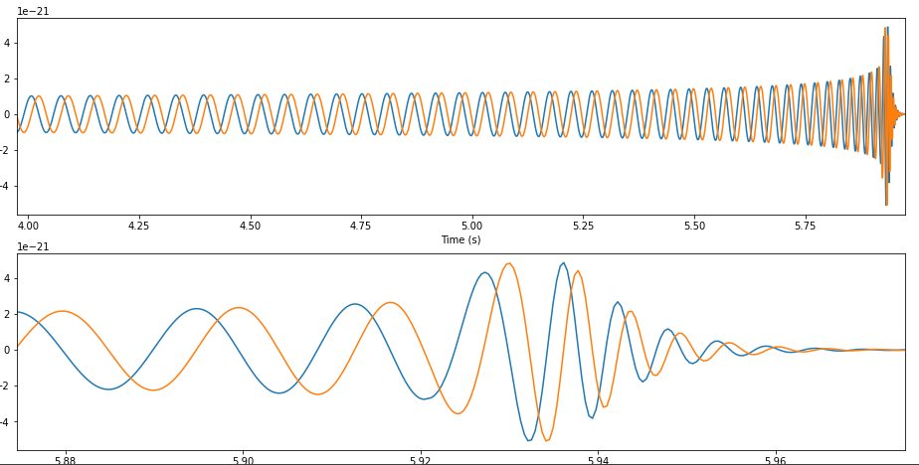
EDA
The purpose of EDA is to understand the data, discover trends and patterns, and present visualizations of the data. From that information, we can find features and models that best fit the data.
Describe the data
HDF5
id & target
Mask the data
Freq (Hz)
H1 (LIGO Hanford detector )
L1 (LIGO Livingston detector )
Visualize frequency of waves
Distributions

Slide 5
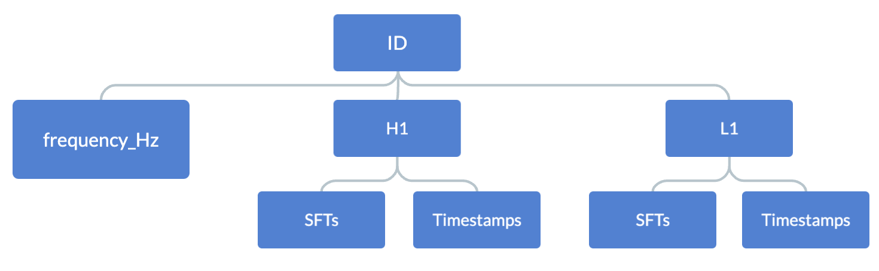
EDA Dataset Map

Slide 6
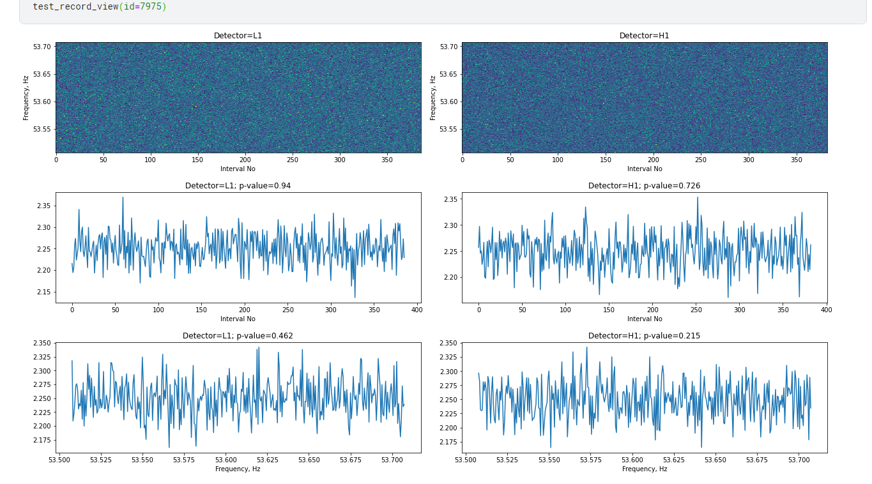
EDA Dataset Map cont.
This is a dataset with signal from gravitational wave (id = 7975, target = 1)
Downside with signal
A lot of noise
Difficult to depict signal

Slide 7
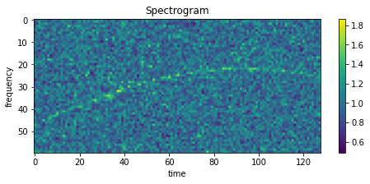
EDA
Visualizing the data for gravitational waves is a bit different compared to other datasets where you can see a timeline, trends and outliers. Sound is usually affected by noise frequencies. Two things that affected the output of the analysis was imbalance between the train/test data and analyzing sound frequencies.

Slide 8
MODELS
We are using 3 models and compare them and choose the model which has the best accuracy.
The models we will be using are:
CNN
LSTM
LGBM
Ensembling models (XGB, CATBOOST, LGBM, RANDOM FOREST)

Slide 9
CNN
Model we are using is tf_efficientnet_b7_ns
EfficientNet is a convolutional neural network architecture and scaling method that uniformly scales all dimensions of depth/width/resolution using a compound coefficient. Unlike conventional practice that arbitrary scales these factors, the EfficientNet scaling method uniformly scales network width, depth, and resolution with a set of fixed scaling coefficients.
It is a generic model that implements many of the efficient models that utilize similar DepthwiseSeparable and InvertedResidual blocks

Slide 10
CNN Cont.
Hyper Parameters :
epochs = 16
batch_size = 16
num_workers = 2
weight_decay = 1e-6
max_grad_norm = 1000
lr_max = 4e-4
epochs_warmup = 1.0
Optimiser - Adam

Slide 11
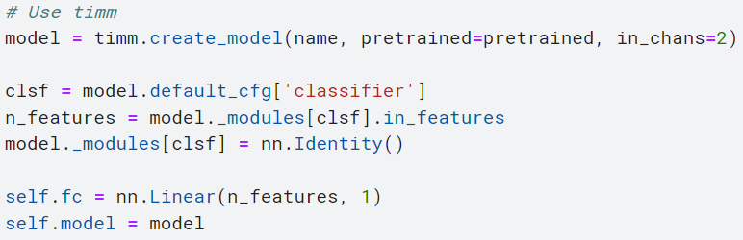
CNN Cont.
This is how we are creating the CNN model first we call the pretrained model. Then add a classifier to it as well as the features it needs to classify. Then finally we add an neural network to complete the model.

Slide 12
Modeling with LSTM in Time Domain
Long short-term memory (LSTM) is an artificial neural network used in the fields of artificial intelligence and deep learning. Unlike standard feedforward neural networks, LSTM has feedback connections. Such a recurrent neural network (RNN) can process not only single data points (such as images), but also entire sequences of data (such as speech or video). For example, LSTM is applicable to tasks such as unsegmented, connected handwriting recognition, speech recognition, machine translation, robot control, video games, and healthcare. LSTM has become the most cited neural network of the 20th century.

Slide 13
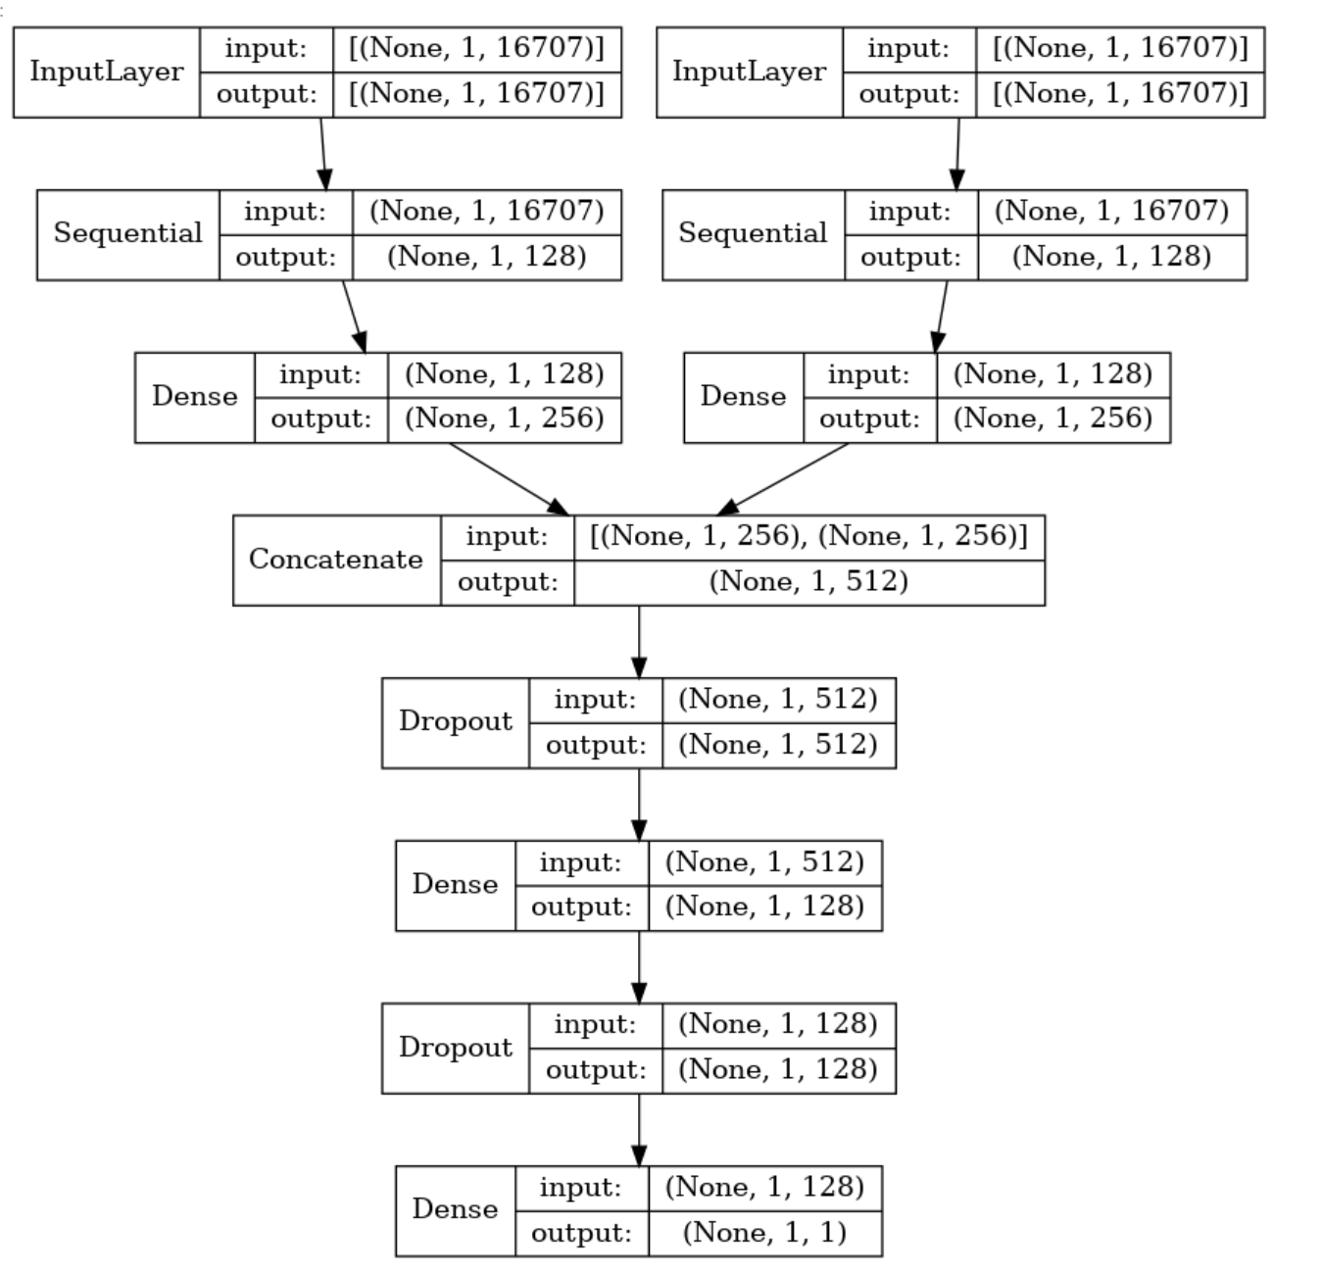
LSTM
Here is the image of how the model works.
We pass through 2 same lstm where input for one is hanford data and livingston for other.
Later we concatenate them and pass them through a couple of dropout and dense layers.

Slide 14
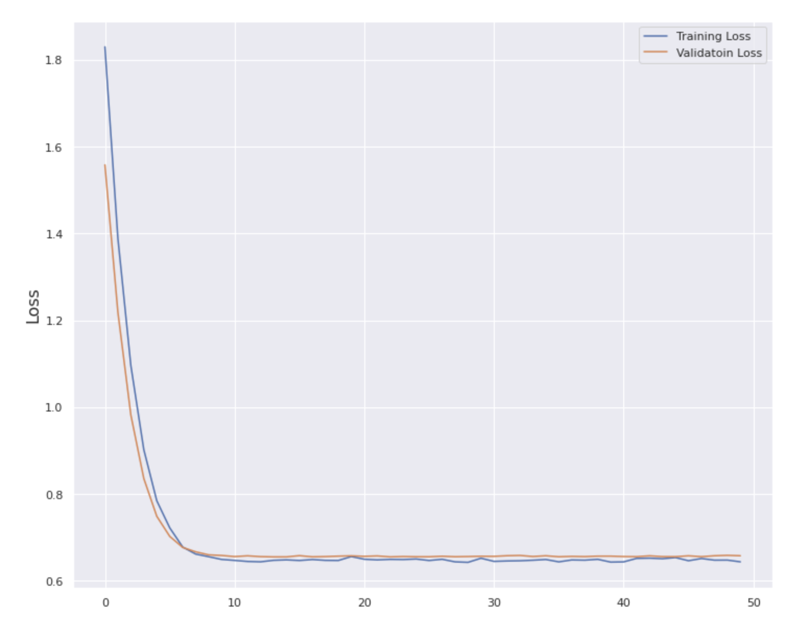
LSTM
Hyper Parameters :
epochs = 50
Loss - Binary entropy loss
Validation split - 0.2
Optimiser - Adam
Metrics - AUC

Slide 15
LGBM
Boosting algorithms are ensemble techniques where you design new models based on the errors observed on the previous models to do further analysis.
One such boosting algorithm is Light Gradient Boosting Machine.
It is designed to be efficient with following advantages:
Faster training speed with higher accuracy
Low memory usage
Support of parallel, distributed and GPU learning

Slide 16
LGBM
LGBM does smart feature engineering and sampling of data to build better models using following techniques:
Smart optimization of splitting(typically histogram)
Exclusive feature bundling
Gradient based one side sampling(GOSS)

Slide 17

LGBM
Problems encountered:
The main problem encountered is imbalanced data.
Solution:
‘EditedNearestNeighbours’ or ENN algorithm wherein we balance minority and majority classes by adding or removing misclassfied data respectively.

Slide 18
LGBM
But, this can lead to loss of valuable information or duplication of data. So, we combine ENN with SMOTE.
SMOTE (Synthetic Minority Oversampling Technique) - create new data points rather than duplicating the existing ones, in case of balancing the minority class - leads to increase in recall at the cost of lower precision.

Slide 19
Ensembling models (XGB, CATBOOST, LGBM, RANDOM FOREST)
In this methodology we are going to train four different models which are XGB, Catboost, LGBM and Random Forest.
Using the stacking ensemble method, stacked generalization consists in stacking the output of individual estimators and using a classifier to compute the final prediction. Stacking allows us to use the strength of each individual estimator by using their output as input of a final estimator.

Slide 20
OPTIMIZATION
Hyperparameter tuning with Keras Tuner
The selection of effective hyperparameters may frequently make or break a machine learning project.
First, we define a model-building function. It takes an hp argument from which you can sample hyperparameters such as hp.Int('units', min_value=32)
Next, instantiate a tuner. You should specify the model-building function, and the name of the objective to optimize (whether to minimize or maximize is automatically inferred for built-in metrics
HyperResnet and HyperXception are two built-in tunable models that Keras Tuner offers in addition to letting you design your own tunable models. Both of these models do searches across different combinations of the ResNet and Xception architectures.

Slide 21
CONCLUSION
Using this project we were able to detect gravitational waves. We tried using multiple models that work well with time series models with frequency data and see which model produced the best result.
We found that the CNN model to be more accurate and efficient compared to the other models (LGBM,LSTM, Ensembling) we tested on.
We have optimized our model by performing Hyperparameter optimization.
Working with Huge data with frequencies as the only data was challenging and we had fun working with it together.

Slide 22
RESULTS AND DISCUSSION
After looking at the data visualization we conclude that the data comes under time series SFT’s data.
After considering all the models we come to the conclusion that the CNN model has the best accuracy and efficiency. So, we conclude to use the CNN model for this project.

Slide 23
LESSONS LEARNT
We learnt how to work with a team in doing a project, maintaining the data in a git repo and working with the same data with different processing and model training methodologies.
Working with huge data and HDF5 files of hundreds of GB size was also challenging and an important lesson that we learnt in this research paper which would be useful for all of us in the future.
We discovered how to train machine learning models using STF and Time series data whose values are in the form of frequencies. We gained knowledge of gravitational waves, their benefits to us, and how to find them.

Slide 24
FUTURE RESEARCH WORKS AND LIMITATIONS
Main limitations of this project were the huge unbalanced data and the fact that there were more data points in the testing set that we needed to predict for than the training set.
The data is also huge which limited us to work on the models at basic settings with limited epochs.
In future as the next steps we would like to concentrate on the CNN model changing the layers in the neural network and focusing on processing the images like gray scaling the images or changing the saturation and contrast values so that the rgb values which show the waves are more enhanced and easily differentiated.
We are considering ensembling multiple models also as another approach where we will be using models which are more compatible to the G2net dataset.

Slide 25
REFERENCES
https://towardsdatascience.com/introduction-to-data-preprocessing-in-machine-learning-a9fa83a5dc9d
https://towardsdatascience.com/convolutional-neural-networks-explained-9cc5188c4939#:~:text=A%20Convolutional%20Neural%20Network%2C%20also,binary%20representation%20of%20visual%20data.
https://towardsdatascience.com/introduction-to-data-preprocessing-in-machine-learning-a9fa83a5dc9d
How to Use XGBoost and LGBM for Time Series Forecasting? | 365 Data Science
lightgbm.LGBMModel — LightGBM 3.3.3.99 documentation
SMOTE | Towards Data Science
EditedNearestNeighbours — Version 0.9.1 (imbalanced-learn.org)
https://en.wikipedia.org/wiki/Gravitational_wave
https://spaceplace.nasa.gov/gravitational-waves/en/
https://en.wikipedia.org/wiki/Long_short-term_memory

Slide 26
THANK YOU

